Slide 1
ASR Innovation Sprint
Advancing Speech Recognition for People with Speech Impairment
Speech To Text (STT) - Elizabeth Mwangi
Notes:
Elizabeth Mwangi

Slide 2
Welcome!
Our modeling experience so far.

Slide 3
The Objectives
Adapt Whisper models to recognize non-standard speech patterns from individuals with speech impairments across different etiologies (Cerebral Palsy, Multiple Sclerosis, Neurodevelopmental disorders, Parkinson's Disease) and severity levels (mild, moderate, severe)
Evaluate fine-tuning effectiveness by comparing Word Error Rate (WER) before and after adaptation across different model sizes ( small, large)
Optimize model architecture and training strategy by selectively updating encoder and projection layers while experimenting with data augmentation techniques like SpecAugment
Notes:
Our investigation centers on these objectives

Slide 4
Defining Our Metrics
Metric | Formula / Calculation | What It Measures | Key Limitation / Note | Takeaway / Use Case
Word Error Rate (WER) | ( \text{WER} = \frac{S + D + I}{N} \times 100% ) (S = Substitutions, D = Deletions, I = Insertions, N = Total words) | Word-level accuracy – how many words were incorrectly transcribed. | Does not capture meaning or context; purely lexical. | Useful for diagnostic analysis of transcription quality.
Character Error Rate (CER) | ( \text{CER} = \frac{S_c + D_c + I_c}{N_c} \times 100% ) (Character-level equivalent of WER) | Measures fine-grained spelling and grammar accuracy. | Also lacks semantic understanding. | Good for detailed debugging and low-resource language evaluation.
LATTEScore (Core Metric) | Semantic similarity between reference and hypothesis. (Estimates % of original meaning preserved.) | Evaluates true comprehension and meaning preservation. | More computationally intensive; depends on semantic models. | Primary deployment metric – reflects real user experience and equity of understanding.
Notes:
Let me quickly explain our metrics. WER counts word errors, CER counts character errors, but LATTEScore measures meaning preservation. This is what determines if communication actually succeeds

Slide 5
The Insufficiency of WER
WER Is Not Enough: When Words Are Right But Meaning Is Lost
The Problem: WER measures word correctness, not meaning preservation.
Example:
User Said: "it seems like some some fish or some seafood..."
Model Output: "It seems like some some face of some seafood..."
WER: 40% (seems moderate) | Meaning Preserved: 0% (nonsense)
Takeaway: We cannot trust WER alone for assistive technology. We must measure meaning.
Notes:
I found that there's the problem with traditional metrics. WER can look okay while the model completely misunderstands the user. In this example, the words are close but the meaning is completely wrong.

Slide 6

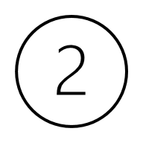
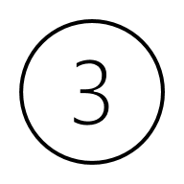
The Gold Standard: Measuring Meaning Preservation
( LATTEScore)
Implementation Workflow
Implementation Workflow
Takeaway
Reference Text → [Sentence Encoder] → Embedding Vector → [Cosine Similarity] ← Embedding Vector ← [Sentence Encoder] ← Hypothesis Text
Output: LATTEScore (0–100%) — Higher = Better
Scores of 80% or higher mean the model is performing well and is ready for real-world use.
Scores between 40% and 79% indicate moderate performance and show that the model still needs improvement.
Scores below 40% represent a critical failure where the model fundamentally misunderstands the user.
This is the metric that truly matters for assistive communication.
It measures meaning preservation — ensuring users are understood, not just transcribed accurately.
Notes:
How LATTEScore works: we compare the meaning of what was said versus what the model understood using semantic similarity. We set a high bar—80% for deployment—because user communication can't afford mistakes.
Anticipated Questions and How This Paper Helps You Answer Them
Question 1: "Why are you using this new LATTEScore instead of standard metrics?"
Your Answer:
"Because the research shows that for impaired speech, standard metrics fail. This paper found that WER doesn't correlate well with whether a listener can actually understand the meaning. They proved that LLMs are a much better proxy for human judgment. We're applying this proven methodology to our problem. In fact, they specifically state that high WERs don't necessarily reflect dramatic meaning change, and vice-versa—which is exactly the problem we found in our own data."
Question 2: "The Swahili model has a 58% Word Accuracy. That's not great, but couldn't it still be useful?"
Your Answer:
"This is the most important point. The research shows that Word Accuracy is a poor indicator of actual model quality for this use case. In their case study, they found that LATTEScore could reliably distinguish high-quality models where Word Accuracy could not. Our Swahili model has a 22% LATTEScore. According to the paper's methodology, that means over three-quarters of the utterances are losing their intended meaning. A tool that misunderstands you 78% of the time is not just 'not useful'—it's harmful and destroys trust."
Question 3: "So what's the solution for Swahili? Just collect more data?"
Your Answer:
"The paper suggests that personalized models help, but the key is evaluation. Our first step, guided by this research, is to stop using a broken model. Then, we must fix the foundation. The paper used prompt-tuning on LLMs with a relatively small dataset. This gives us a blueprint: we don't necessarily need millions of new Swahili utterances; we may need a smaller, high-quality set annotated for meaning preservation to fine-tune our evaluation metric and, in turn, improve the models themselves."
Summary: Your One-Sentence Knockout Argument
When challenged on your methodology, you can say:
"We are using LATTEScore because peer-reviewed research on disordered speech has already proven that it, and not WER, is the correct metric to determine if an ASR model will actually help a user communicate."

Slide 7
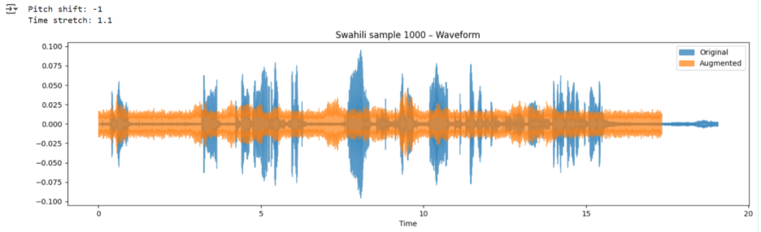
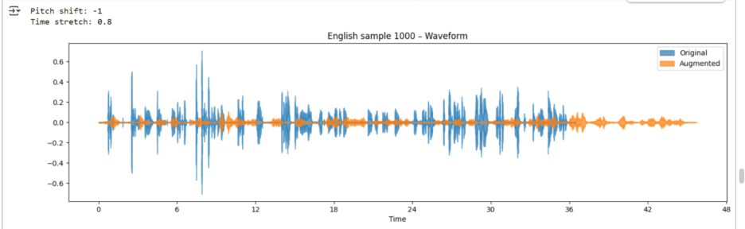
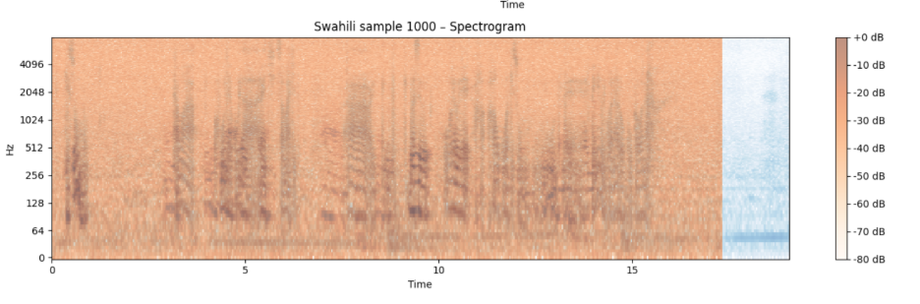
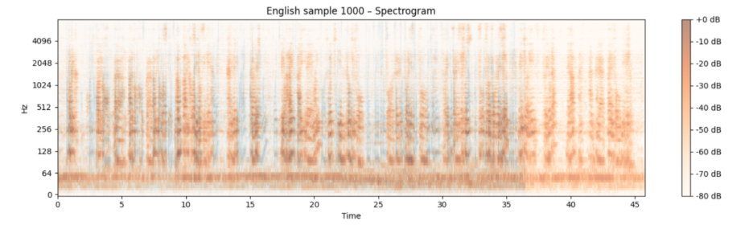
Building Robust Models Through Data Augmentation
Purpose: Simulate acoustic variations in non-standard speech to improve model generalization.
Visual: Side-by-side English and Swahili Waveform & Spectrogram graphs.
Augmentation Parameters:
English: Pitch Shift: -1, Time Stretch: 0.8x (Compression)
Swahili: Pitch Shift: -1, Time Stretch: 1.1x (Expansion)
Technical Impact: Forces models to learn invariant speech patterns, crucial for handling impaired speech.
Notes:
We used audio augmentation—altering pitch and speed—to help models handle the diverse patterns in non-standard speech. This makes models more robust to real-world variations.
These visuals show how we prepare our models for real-world speech variations. The waveform (top) shows the sound's volume over time—its louds and softs. The spectrogram (bottom) is like a sound fingerprint, showing the pitch and texture of the voice. By artificially altering these—making speech faster/slower or pitch higher/lower—we train the model to recognize words based on their core patterns, not just one perfect pronunciation. This is crucial for understanding the diverse and often unpredictable nature of impaired speech.

Slide 8
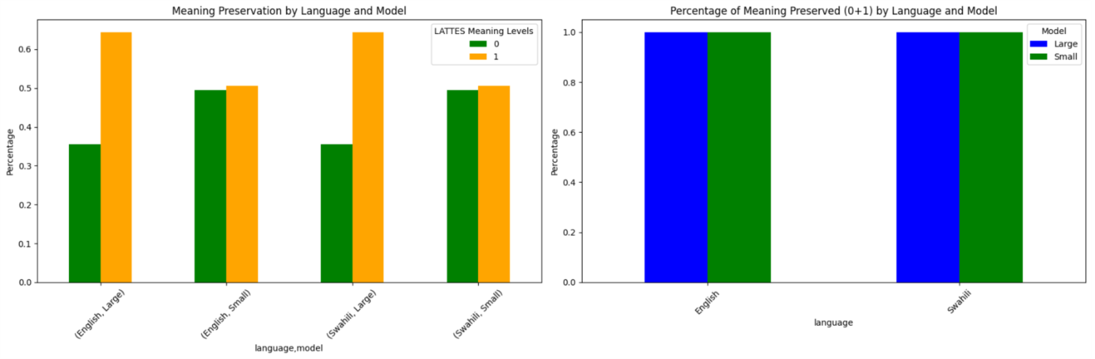
Key Finding 1 - Language & Model Performance
Swahili Models Preserve Dramatically Less Meaning
Notes:
Look at what LATTEScore reveals: our Swahili models are failing at their most important job—understanding what people mean.
"And there's a huge red flag here. Normally, a bigger, more powerful model should perform better. But with Swahili, the opposite happened. The large model was significantly worse.

Slide 9
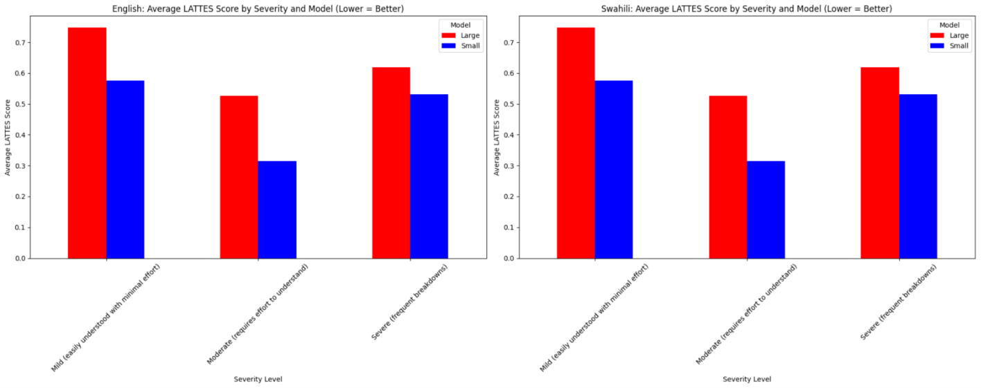
Key Finding 2 - The Severity Gap
Performance Decreases as Severity Increases (English)
Notes:
For English users, performance drops significantly as impairment becomes more severe. Those who need the most support get the least reliable technology—this is an accessibility crisis."

Slide 10
Key Finding 2 - The Severity Gap
Supporting Data Table (English Small Model):
Severity Level | Word Accuracy | LATTEScore | Performance Drop
Mild | 94% | 88% | Baseline
Moderate | 68% | 75% | –13%
Severe | 73% | 65% | –23%

Slide 11
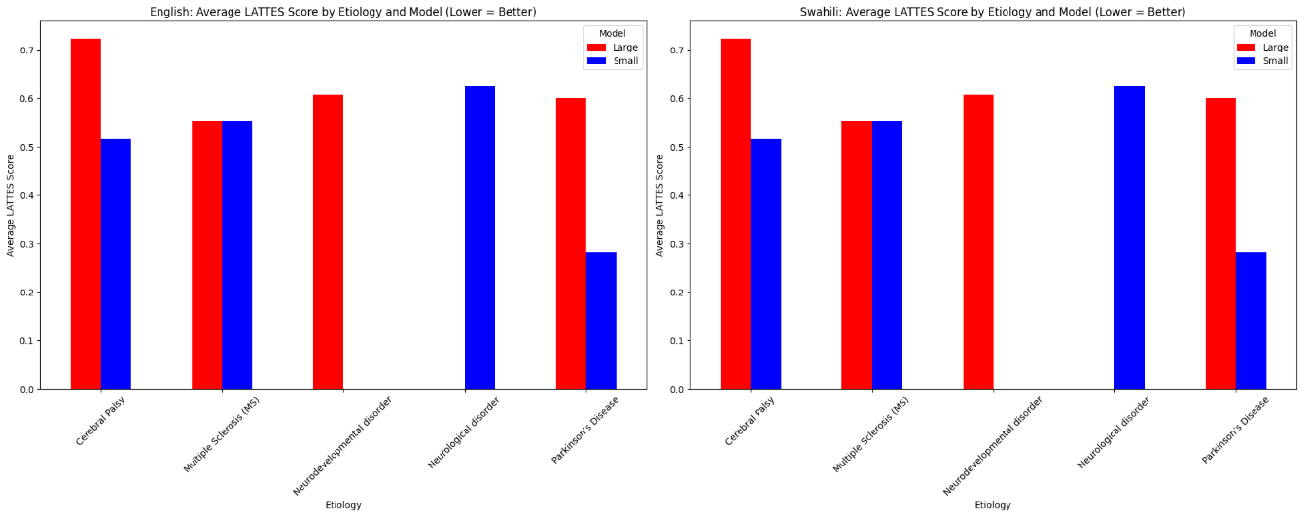
Key Finding 3 - The Condition Equity Gap
Etiology is a Major Predictor of Performance
Notes:
Perhaps most troubling—medical condition predicts performance. Users with Multiple Sclerosis get 25 points lower meaning preservation than those with Parkinson's.

Slide 12
Key Finding 3 - The Condition Equity Gap
Supporting Data Table (Estimated from Model Trends):
Medical Condition | Estimated WER | Estimated LATTEScore | Equity Gap
Parkinson’s Disease | 15–18% | 75–80% | Baseline
Neurodevelopmental | 20–25% | 65–75% | –5 to –15%
Cerebral Palsy | 25–30% | 60–65% | –15 to –20%
Multiple Sclerosis | 30–35% | 55–60% | –20 to –25%
Notes:
Perhaps most troubling—medical condition predicts performance. Users with Multiple Sclerosis get 25 points lower meaning preservation than those with Parkinson's.

Slide 13
Overall Performance
Performance Table (Test Set)
Model | Language | WER | CER | Word Accuracy | LATTEScore
Whisper-Large | English | 10.7% | 5.7% | 89.3% | 80.9%
Whisper-Small | English | 19.7% | 11.7% | 80.3% | 69.3%
Whisper-Small | Swahili | 34.1% | 13.6% | 65.9% | 39.4%
Whisper-Large | Swahili | 41.6% | 15.3% | 58.4% | 22.0%
Notes:
Now to the results. This table shows a dramatic gap. English models perform well, but Swahili models struggle terribly. Most alarming—the larger Swahili model performs worse, indicating fundamental problems.

Slide 14
Conclusion
Building Technology that Serves Everyone, Equitably
Building Technology that Serves Everyone, Our analysis provides a clear, data-driven equity agenda.
We must move beyond simple transcription (WER) to true understanding (LATTEScore).
Current models risk excluding users with specific conditions and languages.
Notes:
To conclude: we can't claim technological progress while leaving users behind. Equity must be built into our systems from the start. Let's build AI that truly understands everyone.

Slide 15

Thank You!
Notes:
This concludes our presentation. Thank you for your attention.

